Slide 1
Nonclassical Measurement Error and Farmers’ Response to Information Treatment
Kibrom Abay, Chris Barrett, Talip Kilic, Heather Moylan,
John Ilukor, Wilbert Drazi Vundru
American Economic Association Annual Meeting presentation
January 8, 2023

Slide 2
Background
Non-classical measurement error (NCME) widespread. Usually treated as a problem to be resolved econometrically or through improved survey design.
NCME may represent more than mere misreporting/noise.
If NCME reflects respondents’ mistaken beliefs (Abay et al. AJAE 2021), it offers a window on respondents’ behaviors, esp. concerning information.
Information interventions rely on subjects updating beliefs. Do they?
Mistaken beliefs could reflect behavioral anomalies: inattention, self-esteem or confirmation bias, etc.
Mistaken beliefs about one subject may spillover to beliefs about, and reporting on, other subjects – with implications for both policy design and statistical inference

Slide 3
What we do
Embed a randomized information experiment within a nationwide agricultural household survey in Malawi to study:
Extent, correlates and persistence of NCME in farmers’ plot size self-reports
Whether/how farmers learn/adjust SRs to demonstrably accurate information about plot size, both in terms of correcting pre-existing measurement error in plot size as well as their reporting behavior (responses) on non-land agricultural inputs.

Slide 4
Experiment
In 2019/20 Malawi IHS5 (LSMS). 72 randomly selected rural EAs, with 24 maize-growing hhs/EA – 16 in treatment, remaining 8 as control group. (Balance tests show randomization worked.)
Control Group
Treatment Group
Mirrors the current interview flow in Malawi IHS5/IHPS and LSMS-ISA-supported surveys
Post-harvest visit only w/unified agricultural questionnaire self-reported in 1 sitting by plot managers, prior to plot visit
Randomly select 1 maize plot and accompany that plot’s manager to the plot for demarcation and GPS-based area measurement
Post-planting + post-harvest visit
Post-planting visit same as post-harvest in control except for information treatment:
After self-reports and plot visit, share GPS-based area and self-report measurement error (in levels and as a share of true area)
Post-harvest visit exactly same as controls:
Ask again about the selected plot area

Slide 5
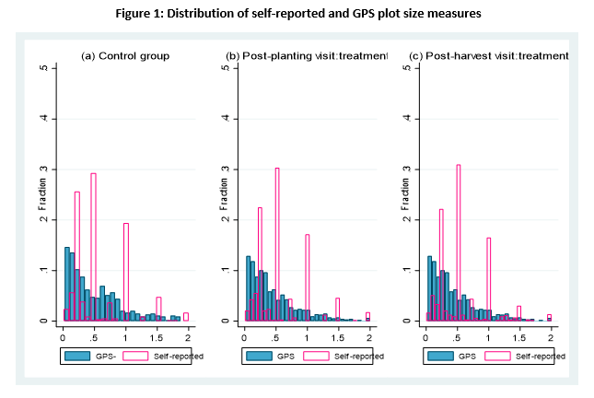
- Regression to mean in NCME: self-reported plot sizes are overestimated for smaller plots, underestimated for larger ones. - NCME is both relatively and absolutely larger for smallest plots. - Rounding is a major source of measurement error in self-reported plot area. - Newer finding: rounding error persists (~unchanged) even after information treatment
Familiar findings on NCME … and newer ones

Slide 6
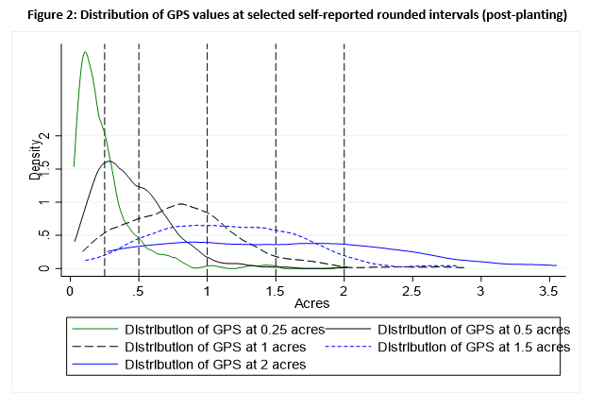
- Heaping around focal plots is asymmetric, esp. for smallest plots
Newer findings on NCME

Slide 7
- NCME is the norm. Only 3.1% (31/982) accurately self-report plot size pre-treatment. - ME is heavily NC, and overwhelmingly associated w/true plot size and rounding
Newer findings on NCME

Slide 8
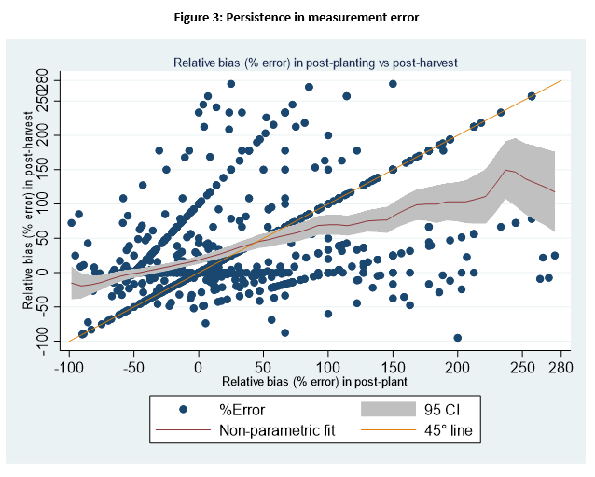
Learning is sluggish among treated… 3-4 months after info treatment: - 13% accurately self-report post-treatment. - Plurality (37%) don’t change incorrect beliefs. - 23% report larger ME post-treatment! - 13% switch from one rounded, wrong value for another wrong, rounded one.
Newer findings on NCME and learning

Slide 9
Newer findings on NCME and learning
Incomplete and structurally asymmetric learning: Only 13% (up from 3%) correct. Overestimation magnitude unchanged but underestimation falls. Under-estimators with larger plots more likely to update and by a larger amount.

Slide 10
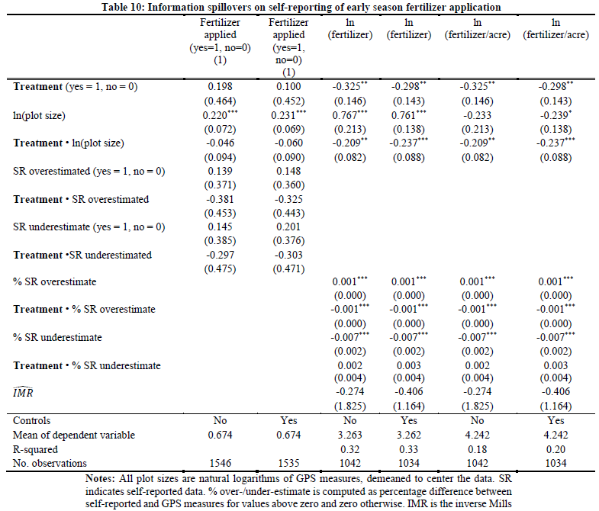
Information treatment has - no effect on fertilizer use reporting at extensive margin - significantly changes intensive margin self-reports (~7%). - treatment effects heterogeneous by plot size and by under/over-estimation. - clear evidence of spillovers on self-reporting of (early season) agricultural input use ... correlated NCME (Abay et al. JDE 2019). Optimal prediction error (Hyslop and Imbens JBES 2001)?
Newer findings on NCME and learning

Slide 11
Systematic NCME strikingly consistent w/behavioral phenomena: - Inattention to salient information: may be rational (costs>benefits) or irrational (mental gaps, oversight). Variation with true plot size suggests structurally asymmetric inattention. - Self-esteem bias: land a source of status. Upwardly biased mistaken beliefs may bring non-material reward. Asymmetric NCME and focal point bunching consistent w/this. - Trust in GPS/technology and/or those who use it vs. trust in original (mis)info source. These seem hypotheses/mechanisms worth testing explicitly. We can’t do so in these data.
How to interpret?

Slide 12
Thank you for your interest and comments k.abay@cgiar.org cbb2@cornell.edu tkilic@worldbank.org

